Slide 1
Guidance for Communicating hotspots: The effective use of sustainability information to drive action and improve performance
Notes:
The hotspots analysis communication guidance is meant to be used to inform the appropriate use and communication of sustainability information derived from a hotspots analysis study. It should be used in tandem with the hotspots analysis methodological framework developed through the UNEP/SETAC Life Cycle Initiative Flagship Project 3a - ‘Hotspots Analysis and Sustainability Information’. This communication guidance has been financed by the Life Cycle Initiative and the project “Advancing and measuring sustainable consumption and production (SCP) for a low-carbon economy in newly industrialised countries (Advance SCP)”. The Advance SCP project is part of the International Climate Initiative (IKI). The Federal Ministry for the Environment, Nature Conservation, Building and Nuclear Safety (BMUB) supports this initiative on the basis of a decision adopted by the German Bundestag.
Authors of the communication guidance:
Mark Barthel (3keel LLP)
Sofia Khan (EY LLP, India)

Slide 2
Contents
Purpose of this guidance and why it is needed?
How to use this guidance?
Rationale behind this guidance
What is hotspots analysis and how it is being applied?
What kind of information is derived from hotspots analysis and what is it used for?
Who are the target audiences for this information?
Examples of hotspots anlaysis communication
General considerations relating to information derived from hotspots analysis
Guiding principles
Validation of hotspots analysis information and communication
Visualising information from hotspots analysis
Best practice examples
Alignment of this guidance with the 10YFP CI-SCP guidelines for providing product sustainability information
Additional references and sources of information
Contacts

Slide 3
Purpose and need for this guidance
Purpose:
To promote the use of clear, accurate and relevant claims and information arising from hotspots analysis to enable actions to be taken by decision-makers and other key stakeholders, including the end users of consumer products
To support the implementation of the hotspots analysis methodological framework
Need:
To understand and follow best practice
To provide clear, unambiguous information which is actionable by those best-placed to address the hotspots identified in any study
To have greater confidence on the claims/information and actions arising from hotspots analysis
To highlight that the ultimate aim of hotspots analysis is to be able to distil and communicate often complex technical information to an end user/consumer in a way that allows them to more easily understand and act on it for significant/optimum sustainability benefit
To align with other standards, codes and guidance (please see other useful references at the end of this guidance)
Notes:
Rationale behind Communicating hotspots: The effective use of sustainability information to drive action and improve performance Guidance and alignment with the Guidelines for Providing Product Sustainability Information
The “What-Why-Who-How” of Communicating hotspots: The effective use of sustainability information to drive action and improve performance Guidance.
What is Communicating hotspots: The effective use of sustainability information to drive action and improve performance Guidance?
The hotspots analysis communication guidance is meant to be used to inform the appropriate use and communication of sustainability information derived from a hotspots analysis study. It should be used in tandem with the hotspots analysis methodological framework developed through the UNEP/SETAC Life Cycle Initiative Flagship Project 3a - ‘Hotspots Analysis and Sustainability Information’, and, in particular, Step 7 of the framework, that involves presenting and communicating the shortlisted hotspots to a wider audience. The guidance helps to ensure that the results from hotspots analysis are used to support informed decision-making and to drive action across the different stakeholders that are best placed to take action, recognising that their information needs and technical knowledge may vary considerably. This communication guidance includes the principles (required and recommended) for effective action to take place, supported by best practice examples, context and specific principles for visualising the results of hotspots studies, based on current practitioner expertise.
Why have we produced the Communicating hotspots: The effective use of sustainability information to drive action and improve performance Guidance?
There is currently an absence of any communication guidance specifically focusing on the needs of those undertaking hotspots analysis studies and those stakeholders that they need to communicate with. As such, the purpose of this guidance is to ensure that the results of the hotspots analysis are used and communicated effectively and lead to the most efficient actions being taken by those best placed to take them, to reduce any impacts and maximise any benefits or opportunities identified during a study. Hotspots analysis is not just an impact and benefits quantification exercise – it is intended to provide actionable information to stakeholders. Therefore, the communication of results to those stakeholders able to take action is a critically important step in any hotspots analysis study.
Who is expected to use the Communicating hotspots: The effective use of sustainability information to drive action and improve performance Guidance?
The hotspots analysis communication guidance is expected to be used by practitioners using the UNEP/SETAC Life Cycle Initiative hotspots analysis methodological framework to drive change; and those wanting to commission a hotspots analysis study. This would include hotspots analysis methodology developers, pratitioners and life cycle experts, sustainability officers, academics, policy developers, marketing professionals, civic societies, trade associations and sector representable bodies, government departments, and agencies, etc.
How the Communicating hotspots: The effective use of sustainability information to drive action and improve performance Guidance fits with the hotspots analysis methodological framework?
The eight steps contained within the UNEP/SETAC Life Cycle Initiative hotspots analysis methodological framework provide an iterative and flexible process, allowing for application at a number of scales / levels (e.g. sector-level or product category-level hotspots analysis), with the user able to define the goals and scope/boundary of their study; and be clear from the start on the volume and timing of stakeholder engagement and involvement. Each hotspots analysis study might be different; however, communication of the results from hotspots analysis to the target audience to enable action is an absolute requirement. For example, Step 7 of the hotspots analysis methodology framework describes the basic process that users need to go through to ensure the efficient and effective use and communication of study findings to a wider audience. This communication guidance supports a number of steps in the methodological framework, providing specific guidance on the principles to be followed and best practice examples of how and who to communicate with to ensure that action is taken.

Slide 4
How to use this guidance
This guidance includes:
A brief background to hotspots analysis
Target audience and examples of communication vehicles
General considerations for communicating information from hotspots analysis
Validation of hotspots communication and information
Core principles for communication
Principles for communicating the information visually
Best practice examples
Other useful reference documents
This guidance is meant to be used alongside the “Hotspots analysis methodological guidance development report” Phase 1 and Phase 2.
Specifically Step 7 - Presentation and Communication of the hotspots analysis methodological guidance
Notes:
The “Hotspots analysis methodological guidance development report” Phase 1 and Phase 2 can be downloaded from http://www.wrap.org.uk/content/principles-and-practices-hotspot-analysis

Slide 5
Rationale behind this communication guidance
What is this communication guidance?
This guidance helps to ensure that the results from hotspots analysis are used to support informed decision-making and to drive action across the different stakeholders that are best placed to take action, recognising that their information needs and technical knowledge may vary considerably.
Why is this communication guidance developed?
Hotspots analysis is not just an impact and benefits quantification exercise – it is intended to provide actionable information to stakeholders. Therefore, the communication of results to those stakeholders able to take action is a critically important step in any hotspots analysis study.
Who is expected to use this communication guidance?
This guidance is expected to be used by practitioners using the UNEP/SETAC LCI hotspots analysis methodological framework to drive change; and those wanting to commission a hotspots analysis study. This would include hotspots analysis methodology developers, pratitioners and life cycle experts, sustainability officers, academics, policy developers, marketing professionals, civic societies, trade associations and sector representable bodies, government departments, and agencies, etc.
How does this guidance fit with the hotspots analysis methodological framework?
Step 7 of the UNEP/SETAC LCI hotspots analysis methodology framework describes the basic process that users need to go through to ensure the efficient and effective use and communication of study findings to a wider audience. This communication guidance supports a number of steps in the methodological framework, providing specific guidance on the principles to be followed and best practice examples of how and who to communicate with to ensure that action is taken.

Slide 6
What is Hotspots Analysis
“A methodological framework that allows for the rapid assimilation and analysis of a range of information sources, including life cycle based and market information, scientific research, expert opinion and stakeholder concerns”. (UNEP 2014)
Purpose
Prioritize and implement solutions
Governance
Precursor for detailed or granular study
Economic
Social
Environmental
Identify Actions
Prioritize significant impacts and benefits
Scale of Application
Product/ Service
Product category
Product portfolio
Lifestyle
Industry sector
City
Country

Slide 7
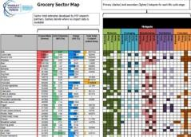
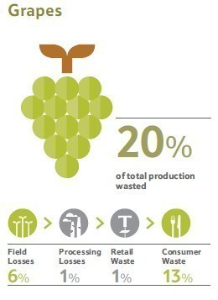
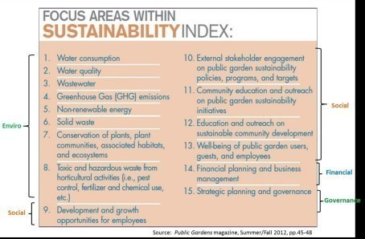
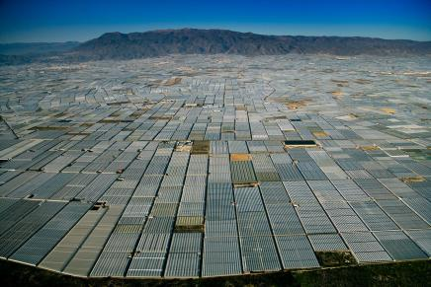
How is Hotspots Analysis being applied?
Pathfinders & pilots
Real world product improvement programmes (pilots, working groups, industry implementation)
Priority Products
Focusing on the products that matter by virtue of their impact and / or sales volumes
Value chain optimisation and resource efficiency
Tesco’s global food loss and waste initiative
Sustainability Indices
From domestic appliances to public gardens
Water catchment management*
Understanding water scarcity hotspots and water resource management
*Greenhouses in San Agustin near Almería, Andalusia, Spain (36°42’ N – 2°44’ W) © Yann Arthus-Bertrand / Altitude
Notes:
NOTES:
First two examples from WRAP’s Product Sustainability Forum (PSF) in the UK:
Top left is a screen shot from the PSF Knowledge Base showing the environmental sustainability hotspots associated with the UK grocery products market, presented in the form of a heat map.
Top middle image on Pathfinder projects undertaken to tackle some of the hotspots identified by the PSF, including whole chain resource efficiency projects to tackle hotspots in the fresh produce, meat, fish and dairy value chains; and sustainable product design Pathfinders to ‘design out’ impacts from the start and ‘design in’ sustainability thinking and issues into retailer’s and brand-owner’s new product development processes and practices.
For more information go to WRAP website – www.wrap.org.uk/psf
Top right image is from work by Tesco (international retailer) and its value chain – (see Tesco and Society Report 2015) – using hotspots analysis to identify, reduce and track food loss and waste in its global food supply chain.
Bottom left example is from work undertaken by thinkstep with the domestic appliances sector in the USA to identify the sustainability hotspots associated with a range of electrical product groups as a precursor to developing sustainability standards and indexes.
Bottom right image of thousands of glasshouses producing fresh produce for the international market in Almeria, Spain – to illustrate work being undertaken by the Water Footprint Network using hotspots analysis to identify the root causes of - and react to - permanent and seasonal water scarcity risks in major river catchments.
All of these examples highlight the power of hotspots analysis to bring together people and organisations facing the same challenges to take collaborative action to identify and then address the hotspots that they identify by working together.

Slide 8
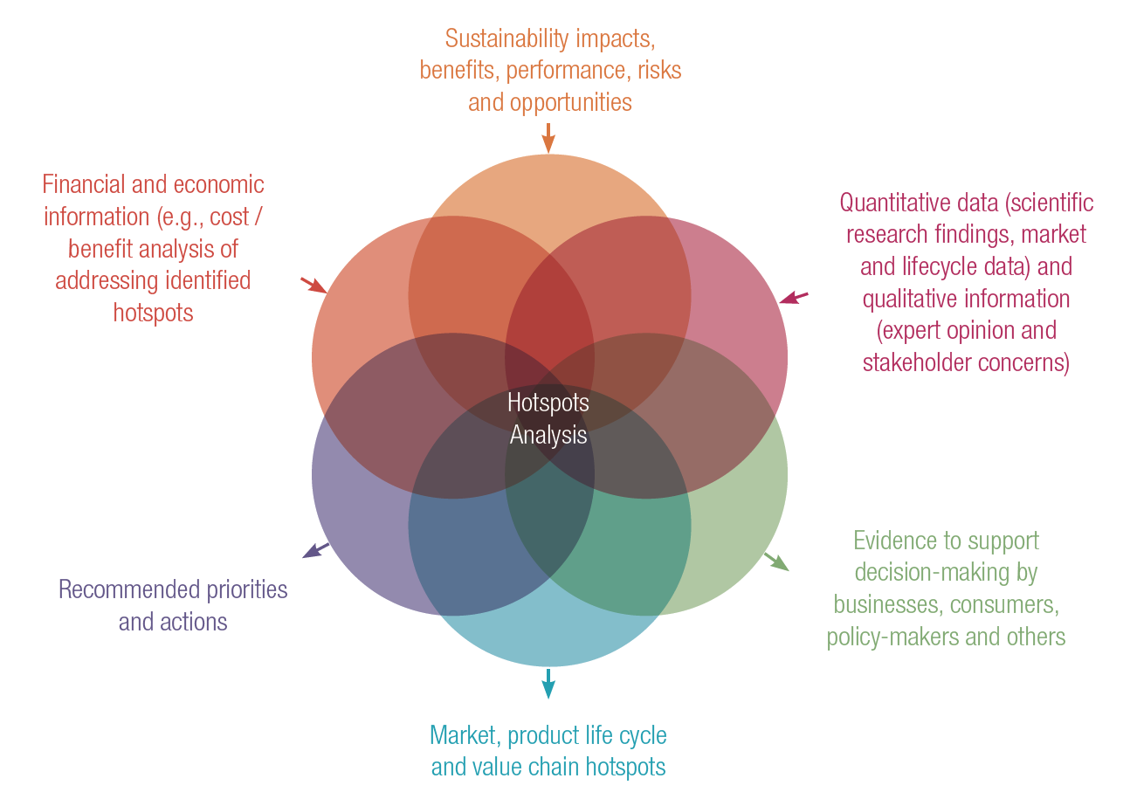
Type of information derived from hotspots analysis

Slide 9
Target Audience(s)
Broader Audience
Target
Audience
Decision makers at NGOs
Government agencies
Academics
Companies
Trade bodies
Leadership and experts at NGOs
Policy researchers and experts
Consumers
Policy developers
Govt officials responsible for policy development
Academic experts and researchers
Chief sustainability officers and expert team members
Product/ service buyers
Technical representatives at trade bodies
Technical Audience
Technical representatives at NGOs / trade bodies
Corporate teams – e.g. technical, sustainability, etc.
Non Technical Audience
Product, Category and Brand Managers
Academics and research institutes
Other subject matter experts – e.g. technical advisers
Relevant government policy experts
Marketing personnel and advertisers
Senior decision-makers (e.g. board members)
Investors / donors
B2B and B2C relationships

Slide 10
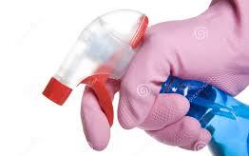
Example from Hotspots Analysis: from information to action
Case Study: Environmental hotspots for a Household Cleaning Product
Hotspots identified
1) Raw materials: 5-7 high impact ingredients
2) Recyclability of pack - trigger assembly not recyclable
3) Product wastage: from inconsistent spray application / dosing
Action
1) Reformulation: chemical to algal surfactants
2) Recyclability: move to single polymer trigger
3) Reduce wastage: redesign nozzle / new dosage information
Communication vehicle
Internal & external communication*
Internal & external communication*
Internal communication, retailers and consumers *(on-pack & at point of sale)
Actors
Product developers & technologists / buyers/ suppliers
Product developers, suppliers, consumers
Product designers, suppliers, marketing team, consumers
*Refer notes below for details
Notes:
NOTES:
Basic information taken from a UK-based hotspots study for a household cleaning product:
Main environmental hotspots identified: 1) high impact raw materials – particularly chemical surfactants used (natural algal surfactant alternative identified); 2) Non-recyclability of trigger assembly: two different plastic polymers and a small steel spring to provide pressure for the trigger (identified solution with suppliers to move to single polymer trigger assembly, replacing steel spring with strong polymer spring; 3) Product wastage due to generic design of trigger nozzle used to spray cleaner on household surfaces (moved to a bespoke nozzle design for specific use with reformulated product and provided on-pack advice to consumers on number of trigger squeezes required to clean household surfaces, backed up with point of sale (shelf edge and on-line) information at product re-launch.
Note importance of working and communicating across internal teams (e.g. product developers and technologists, buying, supply chain management and marketing communications).
Note importance of engaging with key suppliers to communicate findings from hotspots study; and collaboration to find solutions to address the hotspots identified.
Internal communication vehicles could include- face-to-face meetings, written communication, telephone communication, internal circulars, internal emails, intranet etc.
External communication vehicles could include- website, online survey, telephone survey, workshops, webinars, face-to-face meeting, magazines, sector circulars, presentations etc.

Slide 11
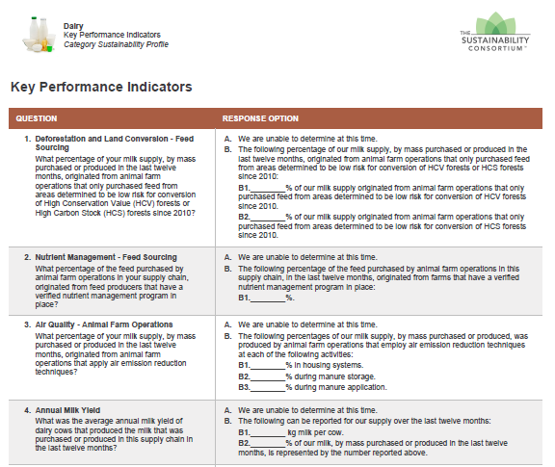
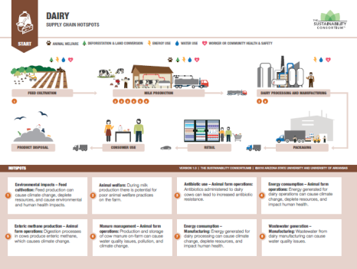
Example for Hotspots Analysis Communication- Product Category
TSC works at the product category level, using a hotspot methodology called the Sustainability Measurement and Reporting System. Below are the different communication vehicles used to enable action from the hotspots results (Example: Dairy)
Key Performance Indicators
Sustainability Insights and Supply chain diagram
Communication by business users: e.g. Walmart’s Sustainability Leaders Badge
Audience: Retailers; Brands / Tier 1 Suppliers
Audience: General public; Business users without sustainability expertise
Audience: Consumers
Notes:
The Sustainability Consortium (TSC) is a global non-profit organization working to transform the consumer goods industry by partnering with leading companies to define, develop, and deliver more sustainable products.
TSC works at the product category level, using a hotspot methodology called the Sustainability Measurement and Reporting System. This uses the best available scientific literature and stakeholder input to identify the most important social and environmental hotspots in each product category. Linked to each hotspot are improvement opportunities that show retailers and brands/suppliers what can be done to reduce the impact of each hotspot.
For each product category, TSC and its business users develop a set of materials designed to educate and inform key audiences. Some examples include:
TSC Key Performance Indicators (KPIs)
Description: KPIs are multiple-choice questions that retailers can use to assess the performance of their brands/suppliers against each of the hotspots. Or brands/suppliers can use the KPIs to self-assess their own performance. IT systems, such as SAP’s Product Stewardship Network, are used to aggregate the supplier responses and to provide benchmarking information to the suppliers and retailers
Audience: Retailers; Brands / Tier 1 Suppliers
Example: Extract from the KPIs for Dairy, covering 5 of the hotspots
Example Output: Benchmarking Data for Dairy Company, Inc. showing their total score against all the Dairy KPIs and how that benchmarks against other (anonymous) companies in the Dairy category
TSC Sustainability Insights
Description: The Sustainability Insights document is a one-page summary of the hotspots and improvement opportunities for a product category. It is written in non-technical language so it is easily understood by non-expert audiences. It is often used as a training aid by retailers and brands/suppliers to introduce sustainability to buyers, product designers and other key roles Audience: General public; Business users without sustainability expertise
Example: Extract from the Sustainability Insights document for Dairy
TSC Supply Chain Diagrams
Description: A Supply Chain Diagram is a graphic representation of the product life cycle that highlights the hotspots, wherever they lie across the value chain. It is often used as a training aid by retailers and brands/suppliers to introduce sustainability to buyers, product designers and other key roles
Audience: General public; Business users without sustainability expertise
Example: Extract from the Supply Chain Diagram for Dairy
Consumer Communications by Business Users
Description: Business users can use the results of the hotspot assessment, and their performance in managing the hotspots to communicate relevant information to consumers. Care must always be taken to provide useful, relevant information that is substantiated by the results of the analysis. Communicating in this way can help consumers make more sustainable choices in the store and in the home, as well as seeing businesses rewarded for their efforts to improve the sustainability of their products
Audience: Consumers
Example: Walmart’s Sustainability Leaders Badge is awarded to brands that perform best against the hotspots in each category. The badge is displayed alongside the product on the Walmart.com online store so that it is clear to consumers when they are choosing a product that performs well on sustainability or not. A dedicated sub-site of the online store also gathers all the Sustainability Leaders products in one place to make it easy for consumers to always buy the most sustainable items.
This is a simple, practical communication for consumers that is underpinned by the original hotspot analysis.

Slide 12
General Considerations
A robust study with clearly defined scope can be used and
communicated in many ways
Availability and clarity of underpinning data and information (including assumptions made and use of any proxy data)
Clarity and transparency around the most material (relevant) and critical issues
Clarity and transparency on extent of expert / stakeholder engagement and consistency
of feedback
Diversity and level of inclusiveness of expert / stakeholder engagement process
Geographical applicability and relevance of hotspots, data, information gathering and expert / stakeholder representation
Use of widely accepted methodology for hotspots analysis

Slide 13
Guiding Principles Overview
Life cycle approach
Reliability
Relevance
Clarity
Collaboration/ Engagement
Transparency

Slide 14
How to Read – Shall, Should and May
The principles described in this guidance uses “shall”, “should” and “may” to distinguish between requirements and recommendations. The terminologies are based on ISO/TS 14072 and ISO 14044/ISO 14040 in that order.
“Shall” is used when this strength of obligation is also required in the
aforementioned guidance documents
“Should” is used to identify recommended elements that can be disregarded
with proper justification.
“May” is used for other allowed elements or alternatives.
Each of the guiding principles have a mandatory (shall) element (sub-aspect) to them. Some also have discretionary/optional sub-aspects (should/may) that are intended to illustrate best practice or offer useful examples on how a given principle can be met.
Notes:
ISO/ TS 14072:2014—Life Cycle Assessment—Requirements and guidelines for organizational life cycle assessment
ISO 1404:2006—Environment Management—Life Cycle Assessment—Requirements and Guidelines
ISO 14040:2006—Environment Management– Life Cycle Assessment—Principles and Framework

Slide 15
Guiding Principles (a)
Guiding principles: a. Life Cycle Approach
Sub Aspects | What it means/ example
The user shall ensure that the information provided reflects impacts / hotspots from all life cycle stages | Information provided shall be material to the shortlisted hotspots identified and acknowledge that there are / may be hotspots in other phases of the lifecycle
The user shall use whole value chain thinking | May specify where the hotspot is physically located; and with relevant stakeholders, communication shall include the best ways or actors to address it (ensuring the ‘actionability’ of information provided)

Slide 16
Guiding Principles (b)
Guiding principles: b. Reliability
Sub Aspects | What it means/ example
Information communicated shall be supported by a clear statement of the level of confidence in the study findings | E.g. quality and completeness of underlying data and information that forms the basis of the study / communication
Users shall ensure that the hotspots methodology used and the way it is applied is appropriate to the way in which information is likely to be communicated | E.g. if the study is not suitable for comparing sectors or products, it should not be used or communicated in such a way
Data quality should reflect the goal and scope of the study and any intended use or communication of findings | Communications should reflect the currency, accuracy and temporal / geographical scope of the underlying study data

Slide 17
Guiding Principles (c)
Guiding principles: c. Relevance
Sub Aspects | What it means/ example
Information* shall be relevant to the scope, actions and solutions identified to address each hotspot | Information* provided shall support/ be supported by the findings of the study e.g. if a shortlisted hotspot exists at end of life, guidance should be provided to help consumers dispose of – or recycle - a product responsibly
The information* provided from study findings shall be relevant and appropriate to the scale of application, system or situation in which it will be used | E.g. information* from a hotspots study on large scale farming in Europe is unlikely to provide a lot of relevant information for produce from a small-scale farm in Latin America; and therefore care should be taken in how it is used
*Information should reflect positive & negative aspects of sector or product performance to enable a reasoned assessment of overall performance.

Slide 18
Guiding Principles (d)
Guiding principles: d. Clarity
Sub Aspects | What it means/ example
Information provided shall be commensurated with the level of confidence in the study findings to support effective decision-making and facilitate action by all relevant stakeholders | Information derived from the study shall be structured in a way that is actionable and provides sufficient context for informed decision-making by technical and non-technical audiences. The use of visualisation (e.g. info-graphics / decision-trees) in support of textual information can support this objective
Clarity shall be provided on sources used to provide the information including exclusions, assumptions and proxies etc. Sources for the information shall be clearly referenced | The target audience should be able to substantiate the information they receive. Any exclusions, assumptions, models and proxies used should be clearly stated to provide clarity and transparency to the target audience and allow for informed decision-making. This would include the sources used to provide information, including the level of confidence that the source provides in relation to the hotspot and the (range of) actions that could be used to address it

Slide 19
Guiding Principles (e)
Guiding principles: e. Collaboration
Sub Aspects | What it means/ example
The type of stakeholders involved, extent of collaboration and feedback shall be considered in planning communications (this may involve consideration of the percentage of the market represented in any stakeholder engagement undertaken during the study)* | E.g. national/ sector representation including stakeholders that represent the most impactful/ actionable life cycle phases. This may include SMEs, academics, corporates, NGOs, etc. Frequency of meetings / consultations with stakeholders; and effectiveness of feedback process e.g. include medium and process to accept or reject feedback.
The most appropriate communications vehicle to use and disseminate the study findings should be considered in planning communications | Issues such as geography, language, mobility and technology should be considered in selecting any communication vehicle e.g. face-to-face meetings, launch events, workshops, webinars or telephone calls; written actions required
The most appropriate feedback mechanisms should be considered for users of the information being communicating to / with | E.g. website, on-line or telephone surveys, email addresses, telephone contact number / enquiry line
*NOTE: as an example, the EU Environmental Footprinting methodology requires more than 50% of a market to be involved in a study.
Notes:
Internal communication vehicles could include- face-to-face meetings, written communication, telephone communication, internal circulars, internal emails, intranet etc.
External communication vehicles could include- website, online survey, telephone survey, workshops, webinars, face-to-face meeting, magazines, sector circulars, presentations etc.
You may refer to example on slide 21 for more context.

Slide 20
Guiding Principles (f)
Guiding principles: f. Transparency
Sub Aspects | What it means/ example
The type of stakeholders involved, extent of engagement and collaboration; and volume and consistency of feedback provided during the hotspots analysis study shall be clearly communicated | e.g. involvement of SMEs, academics, corporates, NGOs, consumer groups, etc. during the study. Meeting intervals with stakeholders, feedback process e.g. include medium and process to accept or reject feedback. Any confidentiality issues should be understood and addressed
The sources and context for study reference materials relating to the information provided shall be transparent to those receiving the information | The sources, context and reliability of the study materials relating to any information provided should be accurately described to ensure that it is useful and credible to end users – e.g. list of published/open/easily accessible materials used in support of communications. Any confidentiality issues should be understood and addressed

Slide 21
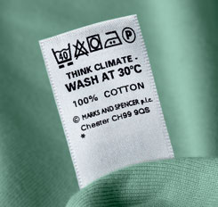
Validation of Hotspots Analysis information & communication
Developing steps and a process for validating: a) the information to be communicated to stakeholders; and b) the most effective communications vehicle for the audience, improves the chances of successful communication and the effectiveness of any actions
3. Validation of impact of communication from the target audience - Done by HSA experts, market researchers, relevant authorities
2. Validation of communication vehicle and visualization for communication and action - Done by HSA experts, relevant authorities, communication experts and infographic designers
1. Technical validation that ensures the information reflects key findings - Done by HSA experts, academics, relevant authorities, NGOs, scientific researchers
On-line / phone surveys, social media, etc.
M&S – Think 30 degrees campaign, lower temperature / impact washing
Use of hot water is identified as a hotspot for clothes and laundry detergents
Notes:
The validation of sustainability information provides credibility to the results of a hotspots analysis study and provides added confidence to the audience for this information, including decision-makers, key internal and external stakeholders and other actors – and helps to ensure that they take the necessary action to address the hotspots identified during a study.
It is also essential to select the most appropriate communications vehicle or channel to reach the audience for this information to ensure that they are aware of the hotspots identified and their roles and responsibilities in addressing them. Wherever possible or necessary, finding the right way to visualize the findings from a study and the actions required can also help to secure the involvement of key stakeholders; and can help you to communicate key information to non-technical audiences.
Once you have confirmed that you are communicating the right information in the right way to the right audiences, then it is always helpful to validate or evaluate the impact of your communications on your target audiences and their response to this information.
As such, this slide suggests there are three levels of possible validation for any communication exercise. These are explained further below and can be incorporated into the communication plan for any hotspots analysis study and results, in order to maximize the potential for engagement with key stakeholders and for action to be taken to tackle known hotspots and improve the performance of the sector or product category under study.
Technical validation: It is important to confirm that the information you are seeking to communicate relates to key findings of your study. For example, that the information reflects the main / priority hotspots identified in the study and the most likely impact reduction opportunities required to tackle them – and is focused on those stakeholders most able to take action.
Validation of communication vehicle and visualization for communication and action: It is important that having identified the right audiences for your communication that you understand their information needs and the most effective communications vehicle or channel to engage them with – e.g. consumer campaign; one-to-one meeting with a key decision-maker; one page summary briefing note, etc. – remembering that your target audience may be technical or non-technical and that their prevailing culture and relative ease of access to communications resources (e.g. internet access; smart phone ownership; efficient postal service) needs to influence and be reflected in your chosen communication vehicle, including any visualizations or graphics that you might want to use. So test and get feedback on your options with representatives from your target audiences using telephone calls or interviews, face-to-face discussions, focus or discussions with the different stakeholders involved in your hotspots analysis study.
Validation of impact of communication: Before you initiate any communication it is often helpful to discuss and agree KPIs to help you assess the impact of your communications at a later stage. For example: increased awareness of the hotspots you’ve communicated; actions taken by different stakeholders to address them; evidence of longer-term behaviour change. Having initiated your communications, you can then use different techniques to determine their impact - e.g. on-line questionnaires or surveys; short telephone interviews; or reviewing or revisiting the evidence from your study to see if the impacts or hotspots you’ve identified have been wholly or partially addressed.
References:
Both the UK-based Product Sustainability Forum Knowledge Base and TSC- The Sustainability Consortium, Sustainability Insights provides sustainability hotspots information for the identified product categories.
https://www.sustainabilityconsortium.org/wp-content/themes/sustainability/assets/pdf/product-categories/Cotton_Sustainability%20Insights.pdf
http://www.wrap.org.uk/content/psf-knowledge-base-0
http://www.reuk.co.uk/Wash-Most-Clothes-at-30-Degrees.htm

Slide 22
Visualisation of Hotspots Analysis (1)
General principles on visualisation of hotspots analysis
Be clear about the scope and context of information you are visualising
Be accurate (not misleading / no potential for misinterpretation)
Be clear in language (use of plain, unambiguous language, no jargon)
Use relevant and easy to understand imagery
Be explicit about the meaning of any symbol, acronym or image used
Provide link or source to obtain more information that can be substantiated
1
2
3
4
5
6

Slide 23
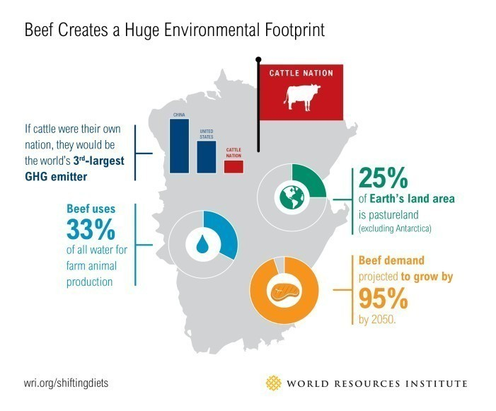
Visualisation of Hotspots Analysis (2)
Clear language, no ambiguity
Explicit about meaning of the symbol used
Clarity in scope
Link available for more information
Relevant and easy to understand imagery
Clarity in scope
Language is simple to understand
Link available for more information
Notes:
http://www.isealalliance.org/infographic/iseals-credibility-principles
https://www.greenbiz.com/article/case-sustainable-food-system-12-charts

Slide 24
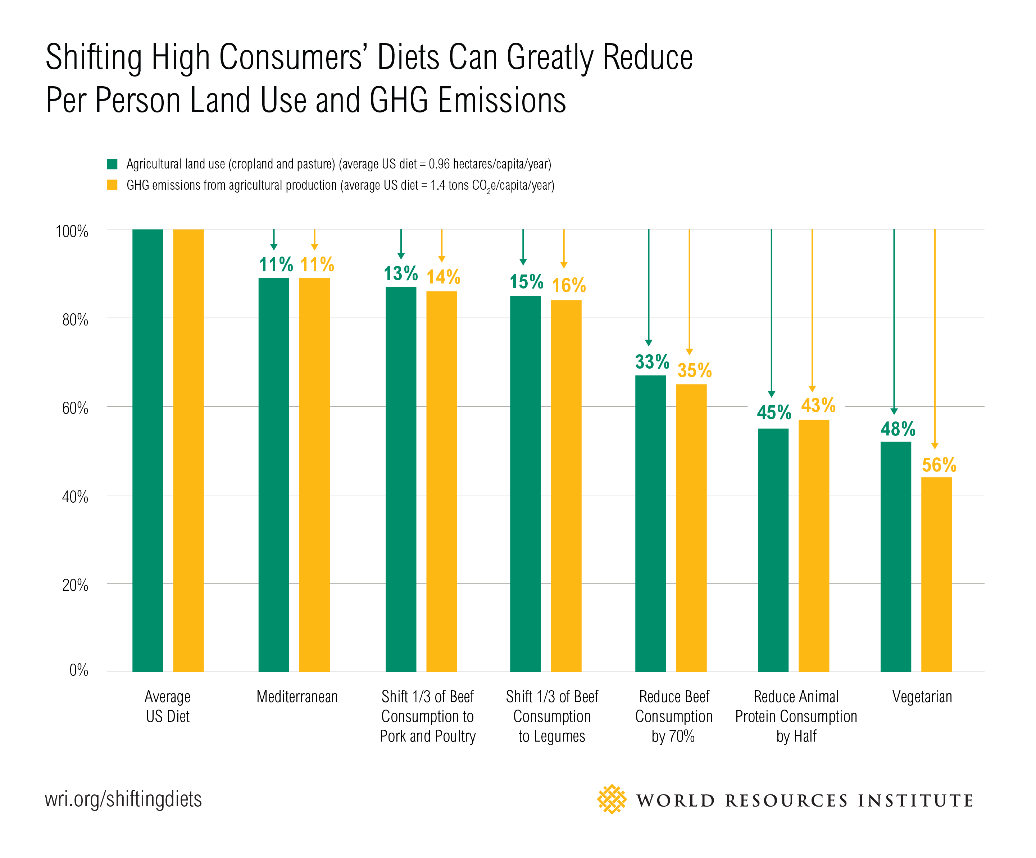
Visualisation of Hotspots Analysis (3)
Action oriented
Language- easy to understand
Clarity in scope
Link available for more information
Scenarios communicated clearly
Imagery simple to understand- no ambiguity
Clarity in scope
Link available for more information
Notes:
http://www.isealalliance.org/infographic/iseals-credibility-principles
https://www.greenbiz.com/article/case-sustainable-food-system-12-charts

Slide 25
Visualisation of Hotspots Analysis (4)
Clarity in scope, data applicability and limitations identified

Slide 26
Linkages to UN SDGs
The UN Sustainable Development Goals (SDGs) (Global Goals For Sustainable Development)
Consider linking the actions taken to reduce the impact of hotspots to the appropriate UN SDG for Communication and Visualization
Notes:
At the United Nations Sustainable Development Summit on 25th September 2015, world leaders adopted the 2030 Agenda for Sustainable Development, which includes a set of 17 Sustainable Development Goals (SDGs), with 169 supporting targets to end poverty, fight inequality and injustice, and tackle climate change by 2030. These are shown in figure 2. Hotspots Analysis can be used to identify and prioritise actions for each of these goals at a product category / sector / city / nation or other level.
For more information on the UN Sustainable Development Goals please visit: http://www.un.org/sustainabledevelopment/sustainable-development-goals/

Slide 27
Alignment of this Communication Guidance with the 10YFP CI-SCP Guidelines for Providing Product Sustainability Information*
Title | Guidelines for Providing Product Sustainability Information | Hotspots Analysis Communication Guidance
Purpose | International guidance for reliable sustainability information and product-related communications and claims. | Use and communication of information derived from hotspots analysis and the communication of results to those actors best placed to take action to address hotspots
Target audience | Information providers and ‘watchdogs’, such as producers and retailers, marketing professionals, procurers, governments, market surveillance bodies, NGOs, as well as labelling bodies. | Direct and indirect, technical and non-technical audiences depending on the goal and scope of hotspots analysis. e.g. Chief Sustainability Officers, product developers, marketing professionals, government bodies, civil society groups, policy makers, etc.
Main difference in approaches to underlying principles | Life Cycle Thinking is an underlying/ encouraged principle, not mandatory. Relevance (covering significant aspects, i.e. hotspots) is required | Life Cycle Thinking is a required principle
Application | Products ( goods and services) | Products, product categories, sectors of the economy, city-scale, national-level
Visualisation principles | Not covered yet | Covered – including best practice examples
Principles alignment | Principle are aligned in context with the purpose | Principles are aligned in context with the purpose
Notes:
*About the 10YFP CI-SCP Guidelines for Providing Product Sustainability Information
http://www.scpclearinghouse.org/consumer-information-scp
Using a global multi-stakeholder approach, the 10YFP Consumer Information for Sustainable Consumption and Production Programme (CI-SCP) developed international guidance for the provision of reliable sustainability information and communications on products - to enhance consumer awareness, ease the uptake of more sustainable choices during the purchase, use/re-use, disposal and recycling of consumer products. By guiding and encouraging information providers to communicate reliably, the Guidelines for providing product sustainability information aim to address the underlying causes of information overload, consumer confusion and a lack of credibility, that has often led to mistrust amongst consumers, who are becoming increasingly aware of ‘greenwash’ and dishonest or misleading product claims. The 10YFP CI-SCP Guidelines for providing product sustainability information ultimately aim to create a level playing field for – and encourage companies to provide reliable sustainability information to consumers on their goods and services.
The Guidelines include a comprehensive set of high-level principles for users to follow, from fundamental to aspirational, and guidance on how to apply them. The Guidelines aim to be useful to developed and developing countries alike and implementable for companies of all sizes operating in different markets.
* About Communicating hotspots: The effective use of sustainability information to drive action and improve performance Guidance: The Hotspots Analysis Communications Guidance is meant to be used in tandem with the hotspots analysis methodological framework developed as part the second phase of the UNEP/SETAC Life Cycle Initiative Flagship Project 3a - ‘Hotspots Analysis and Sustainability Information’ and which contributes to the work plan of the Consumer Information Programme of the 10 Year Framework of Programmes on Sustainable Consumption and Production (10YFP). The hotspots analysis communication guidance has been specifically developed to provide guidance to those wishing to responsibly use the findings and sustainability information derived from hotspots analysis studies. It includes mandatory and optional principles to support the effective communication and visualisation of hotspots analysis results, with the primary aim of enabling action by decision-makers and others based on the potential solutions identified to address priority hotspots. It also provides best practice examples, helps users to identify their target audience(s); and includes information on how to validate the use of findings, the most appropriate communications channels and the impact of any communications made.

Slide 28
Additional references & sources
Additional references and sources of information:
ISEAL (2015b). Building demand for sustainable commodities. How brands and retailers are engaging domestic markets in Brazil, China and India (London: ISEAL Alliance)
Green Claims Guidance (2011) DEFRA
Mikael Klintman (2015). A Review of Public Policies Relating to the Use of Environmental Labelling and Information Schemes (ELIS)
The Consumer Ombudsman Norway (2009). The Consumer Ombudsman’s Guidelines on the Use of Environmental and Ethical Claims in Marketing (Norway)
ISO (2000). ISO 14020:2000 Environmental labels and declarations – General Principles (Geneva: International Organization for Standardization)
United Nations (2003). United Nations Guidelines for Consumer Protection.
10YFP CI-SCP Guidelines for providing product sustainability information (forthcoming).
http://www.isealalliance.org/infographic/iseals-credibility-principles
https://www.greenbiz.com/article/case-sustainable-food-system-12-charts

Slide 29
Additional references & sources (2)
Additional references and sources of information:
Code of Advertising and Marketing (ICC, 2011),
Environmental Footprint Guide (European Commission, 2013)
European Meta Study on Environmental Information Guidelines (DG Justice, 2015),
ISO 14021 (ISO, 2000)
Five Universal Truths “Challenge the label” (ISEAL, 2015b)
OECD (Mikael Klintman, 2015)
GENICES – Member Guide (GEN, n.n.)
Claims or fair eco-advertising in Practice (CENIA, 2010)
Credibility Principles (ISEAL, 2013)

Slide 30
Contacts
To learn more about the Life Cycle Initiative, please refer to www.lifecycleinitiative.org
Contact: info@lifecycleinitiative.org
To learn more about the 10YFP Consumer Information Programme for Sustainable Consumption and Production, please refer to http://www.scpclearinghouse.org/consumer-information-scp
Contact: ciscp@unep.org

